Slide 1

CTFs’, Codes & Ciphers
Meenakshi S L

Slide 2


Who am I?
B-Tech Computer Science undergraduate at Amrita University
Member of Team Shakti
India’s first women-only student CTF Team
Member of Team bi0s
India’s No 1 CTF team

Slide 3
What are CTFs
Table of Contents
01
An intro to the cyberworld
Codes and Ciphers
02
Cryptography?
Tips and Tricks
03
Some tips to get you started
04

Slide 4
CTFs
The Codechef of CyberSecurity

Slide 5
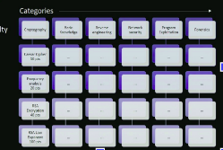
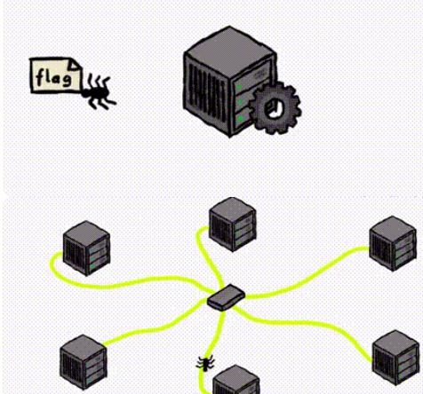
Teams attempt challenges in various categories
Jeopardy
Types of CTFS
All teams are connected to a server through a vm provided by the organiser which has services running and and flags planted in the VM’s.
Teams attack the other teams by finding vulnerabilities on their systems and patching their services to not lose their flags.
Attack Defense

Slide 6
What’s the point?
Game Format
To attract kids as well as Adults
Each solve gives you points and who doesn't love their name on top of their scoreboard
Team
Team members motivate and collaborate to solve challenges
It's always more fun to share work.
Educate
Keeping track of latest developments and vulnerabilities - CVE, Exploits, etc
Building Community
Helps bring together the cyber security enthusiasts - just like this workshop right here

Slide 7
Categories in a CTF
Newer categories include
OSINT
Hardware
Pentest
Even Satellite hacking!!
Fun Stuff ?!!
The “Classic” ones
Web Exploitation
Reverse Engineering
Cryptography
Forensics
PWN

Slide 8
Codes and Ciphers

Slide 9
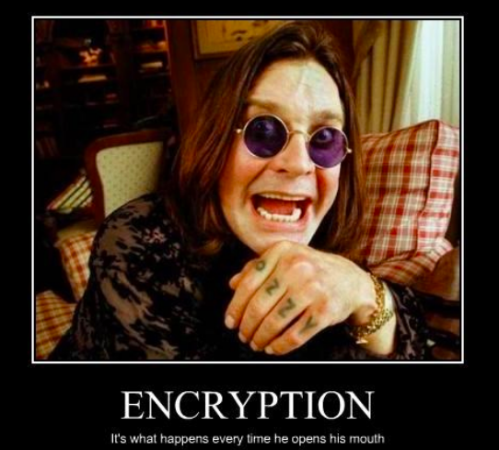
What is Cryptography?
Protecting data into a form unreadable by an eavesdropper.
Only authorised parties shall be able to read it

Slide 10


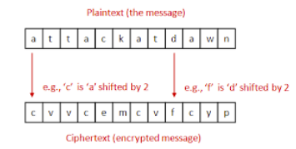

Let’s learn through example

Slide 11
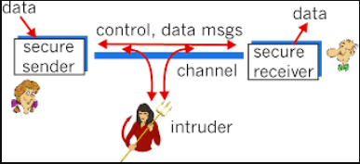
Basic Terms

Slide 12
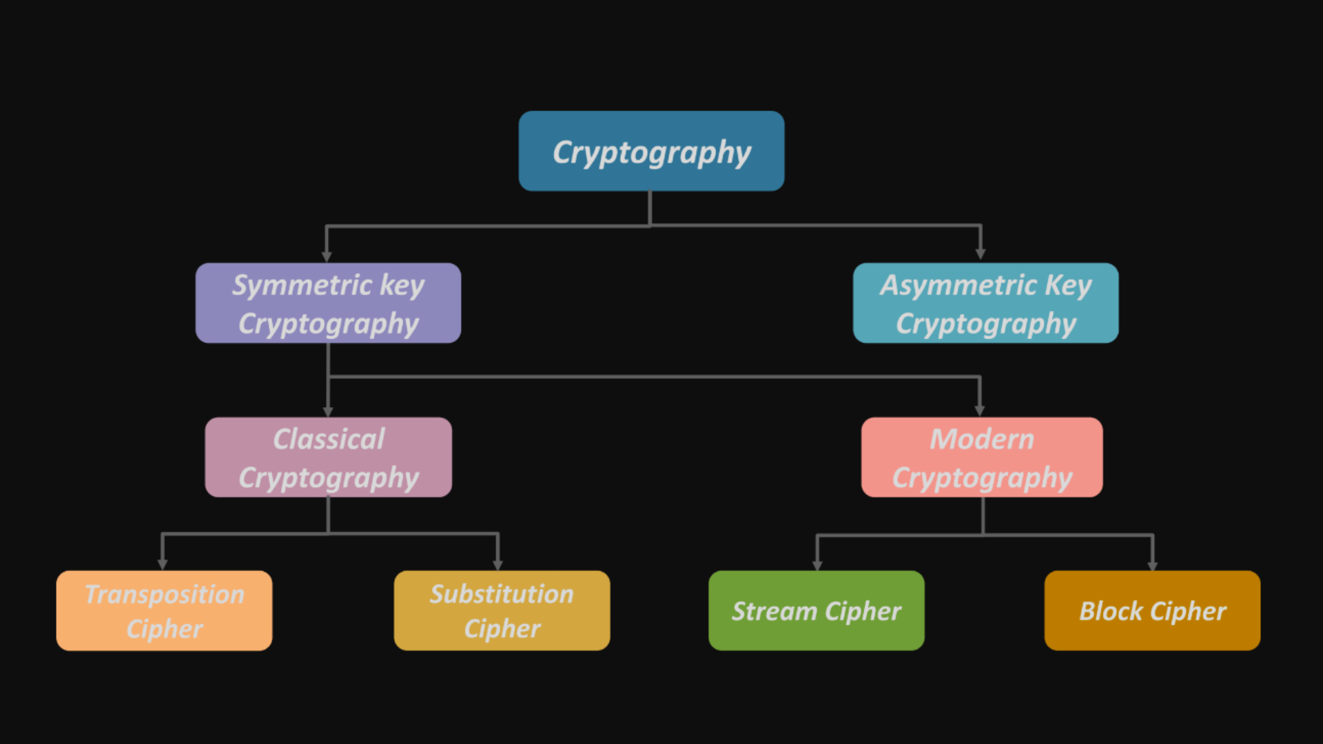
Classification of Cryptosystems

Slide 13
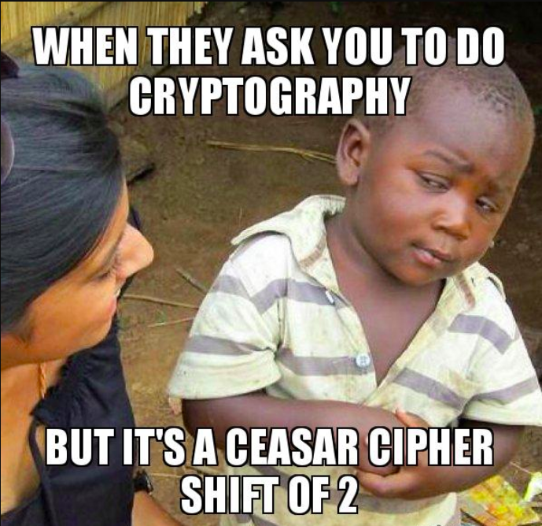
Substitution Cipher
Analysis of Caesar's cipher
Each character is mapped to its corresponding Ciphertext
Symmetric Key
One key for Encryption and Decryption
Key space is 26
Possible keys are from
1 to 26
Not Secure!
Offers no Security to message transfer

Slide 14
Attacks on substitution ciphers
Frequency analysis
Bruteforce Attack
Known Plaintext
ETAOIN SHRDLU does the trick!
The key space is 26
ASCII ( Plaintext - Ciphertext) =KEY

Slide 15
RSA
Rivest Shamir Adleman

Slide 16
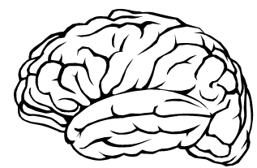
Principle behind RSA
Complexity of Prime Factorisation
Basically 7 x 11 = 77 is easier than 77 = 7 x 11
Wait What?
What if I say factor 1085940785394849313485206334997983274091371319495340710907396269536753306403?
Yeah..

Slide 17
Algorithm
Key Generation
Encryption
Decryption

Slide 18
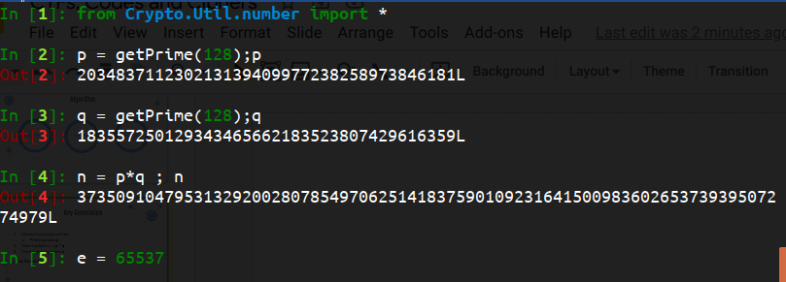
Key Generation
Choose two large primes
Primes p and q
Take modulus n = p * q
Choose the exponent e
(n, e): Public Key
Note :Choose e such that 1 < e < φ(n)

Slide 19
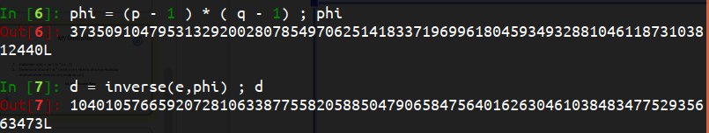
Key Generation
Calculate φ(n) = (p - 1) * (q - 1)
Determine d as d ≡ e⁻¹ (mod φ(n)); that is, d is the modular multiplicative inverse of e modulo φ(n)
(d, e): Private Key

Slide 20
Encryption
Message M → integer m ; 0 <= m < n
C ≅ m ** e mod n
Decryption
m ≅ C ** d mod n

Slide 21
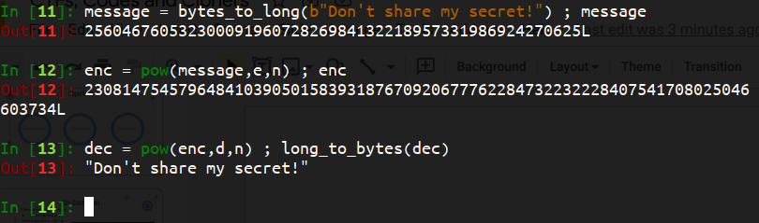
Encryption & Decryption

Slide 22
….not always
Depends on the choice of keys
Let’s look at some scenarios...
So it’s safe?

Slide 23
if n is factorisable easily
Calculate φ(n)
Calculate d and get the message

Slide 24
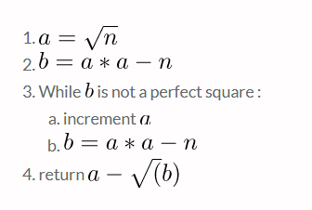
Fermat’s attack - A sample scenario
Sometimes the primes are just a little too close
Fermat’s algorithm is used to get factorise n

Slide 25
A scenario : Weak RSA , Pragyan CTF 2015
b <0 so it can’t be a perfect square
So keep incrementing

Slide 26




Continuation….
b is a perfect square
Now find p

Slide 27
Small public Exponent
Message m is encrypted with n and e = 3
C = m**e % n
m**e < n (here)

Slide 28
Resources I found useful
Crypton
https://github.com/ashutosh1206/Crypton/
Cryptohack
https://cryptohack.org/
Past CTF challenges

Slide 29
Tips and Tricks

Slide 30

Mastering the art
Python is your tool
Google
Stuck? Ask!
Knowing a programming language is a must
Improve your googling skills
Nobody is born an expert
Document your work
Play more CTFs
Github, blogs etc
Practice makes one perfect

Slide 31

￼
Shakti CTF
Opportunity for women
Individual Jeopardy CTF
an effort to promote women into cybersecurity

Slide 32

Thank you

